Slide 1
Data Structure & Algorithms
Mr. Ali Haider
Institute Of Management Sciences

Slide 2
History
From Latin matrix — womb, origin, mother (fem. of mater)
Literal Meaning: A place where something is formed or generated.
In Mathematics:→ A structured container that holds numbers
→ Enables transformations, solutions, and new data
Symbolism: Like a womb, a matrix produces output from input
Across Fields:
Biology: Extracellular matrix = cell support
Manufacturing: Mold matrix = shape origin
Geology: Rock matrix = crystal bed
Fiction: The Matrix = digital origin world
Core Idea: A matrix is a source, a framework that enables creation and structure

Slide 3
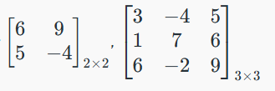
Matrics
Matrices are key concepts in mathematics, widely used in solving equations and problems in fields like physics and computer science. A matrix is simply a grid of numbers, and a determinant is a value calculated from a square matrix.
A matrix is a rectangular array of elements arranged in rows and columns. It can be defined as an m×n matrix, where m represents the number of rows, and n represents the number of columns. The elements in the matrix can be real numbers, complex numbers, or unknown variables.

Slide 4
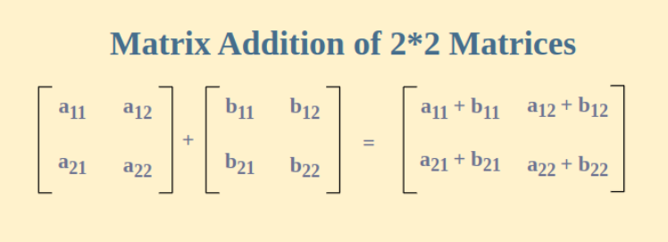
ADD/SUBTRACT

Slide 5
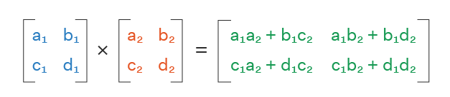
Multiplication
Multiplying two matrics have many types.
Dot, Standard (Naïve), Strassen, Winograd etc.
Standard Matrics Multiplication :
C[i][j] += A[i][k] * B[k][j];

Slide 6
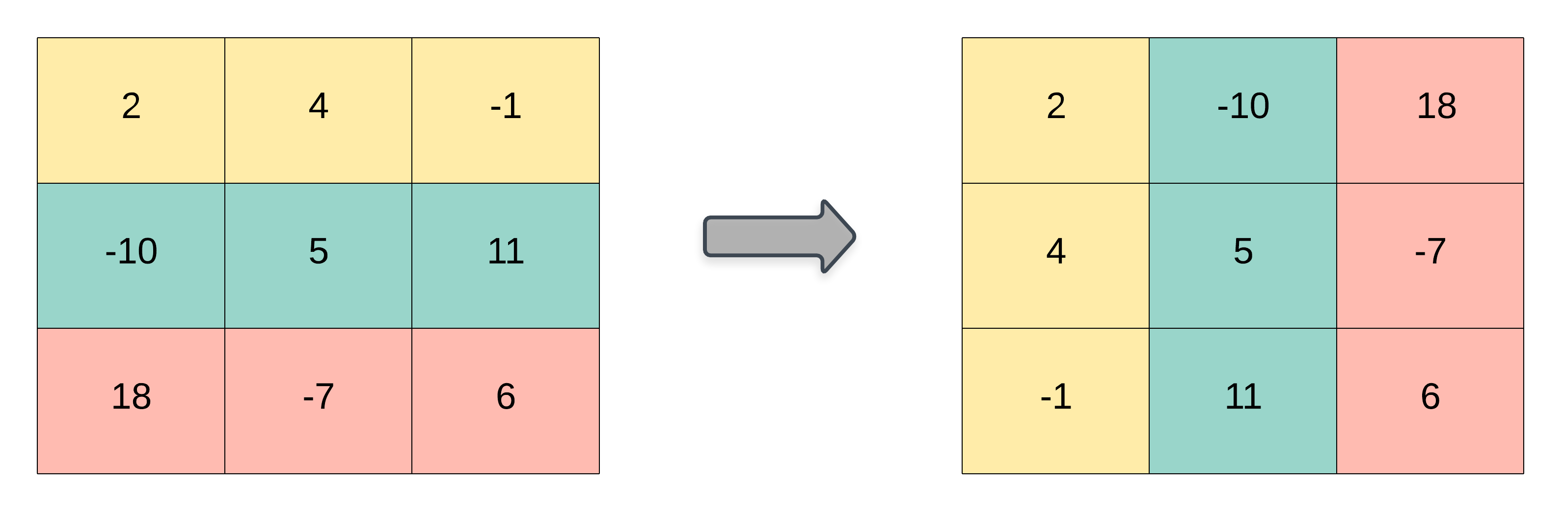
Transpose
Switch rows with columns. That is:
The 1st row becomes the 1st column
The 2nd row becomes the 2nd column, etc.

Slide 7
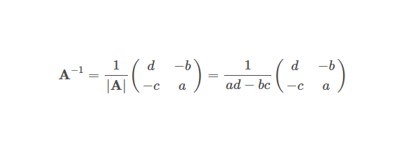
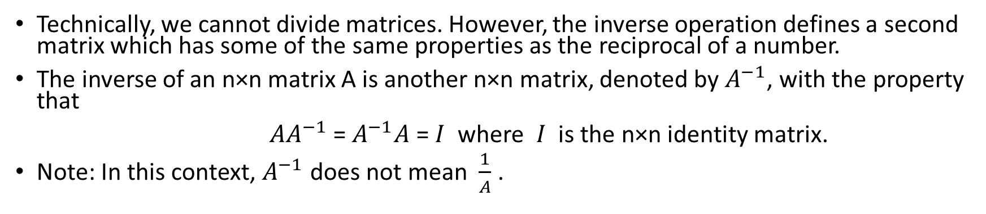
Inverse of Matrix
Technically, we cannot divide matrices. However, the inverse operation defines a second matrix which has some of the same properties as the reciprocal of a number.
The inverse of an n×n matrix A is another n×n matrix, denoted by $A^{−1}$, with the property that
$AA^{−1}$= $A^{−1}A$ = $I$ where $I$ is the n×n identity matrix.
Note: In this context, $A^{−1}$ does not mean $\frac{1}{A}$.

Slide 8
Thank You.
The End

